Slide 1
計算物理
Schrödinger equation

Slide 2
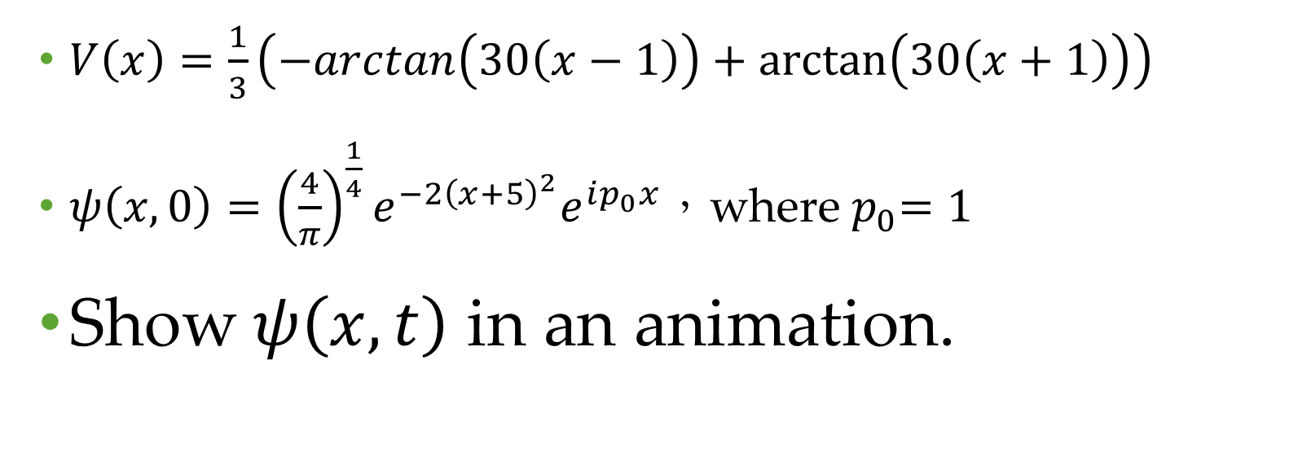
Problem
$V\left(x\right)=\frac{1}{3}\left(−arctan\left(30\left(x−1\right)\right)+\arctan\left(30\left(x+1\right)\right)\right)$
$ψ\left(x,0\right)={\left(\frac{4}{π}\right)}^{\frac{1}{4}}e^{−2{\left(x+5\right)}^{2}}e^{ip_{0}x}，$where${ p}_{0}=1$
Show$ψ\left(x,t\right)$ in an animation.

Slide 3
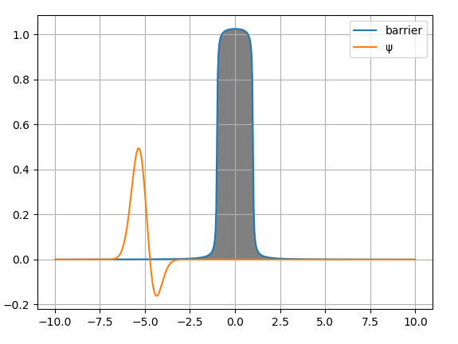

Slide 4
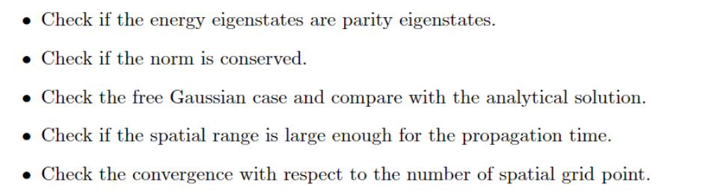

Checked

Slide 5
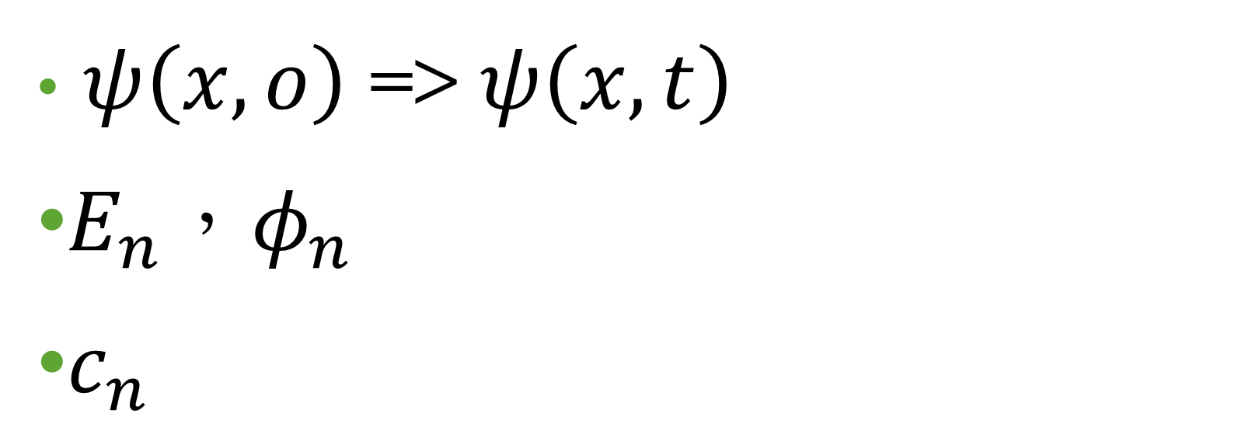
What we need ?
$ψ\left(x,o\right)$ => $ψ\left(x,t\right)$
$E_{n}，φ_{n}$
$c_{n}$

Slide 6
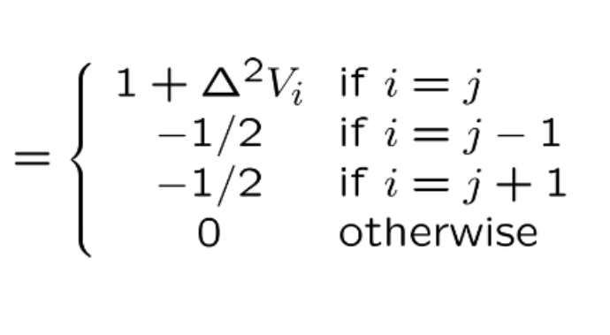

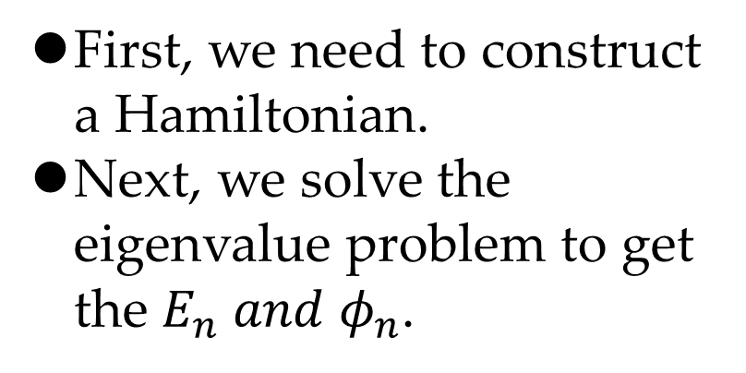
How to get $E_{n} φ_{n} ?$
First, we need to construct a Hamiltonian.
Next, we solve the eigenvalue problem to get the $E_{n} and φ_{n}$.

Slide 7
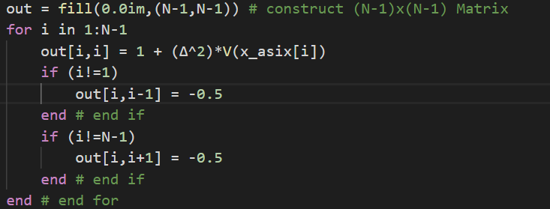
Construct my Hamiltonian

Slide 8
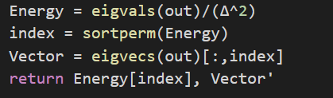
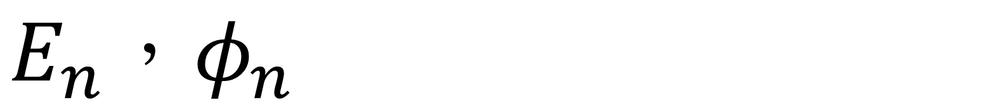
$$E_{n}{，φ}_{n}$$

Slide 9
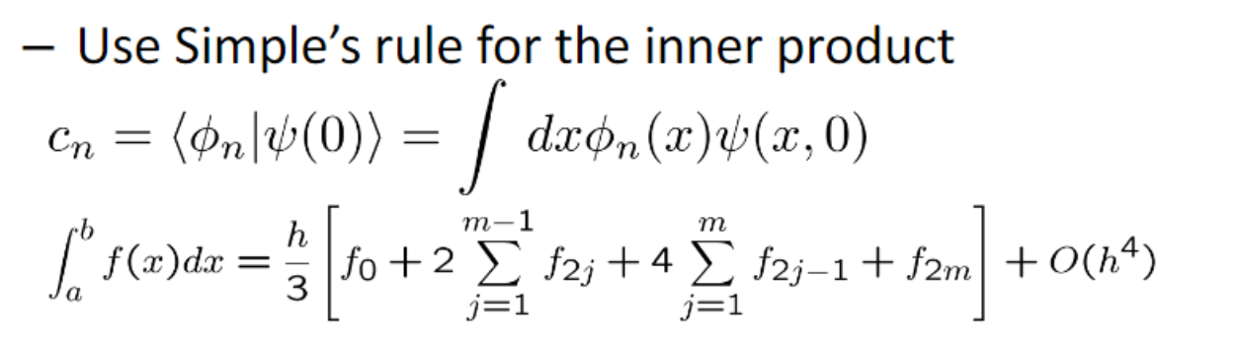

How to get $c_{n} ?$

Slide 10
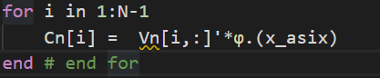
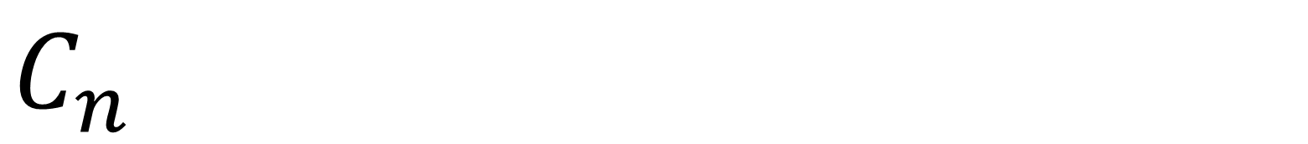
$$C_{n}$$
I use inner product

Slide 11
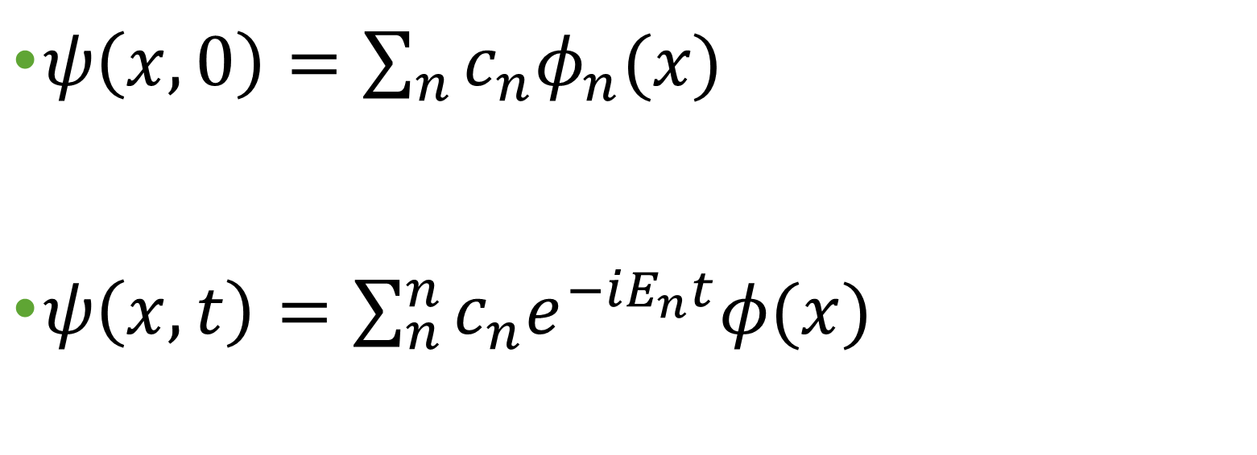

Time dependent $ψ(x,t)$
$ψ\left(x,0\right)=\sum_{n}{c_{n}φ_{n}(x)}$
$ψ\left(x,t\right)=\sum_{n}^{n}{c_{n}e^{−iE_{n}t}φ(x)}$

Slide 12
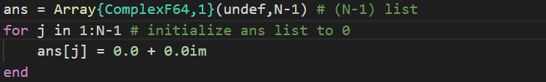
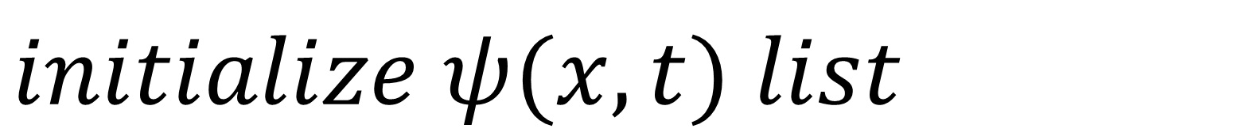
$$initialize ψ(x,t) list$$

Slide 13
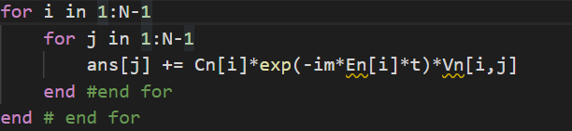



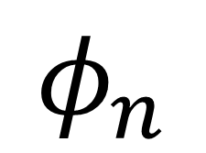
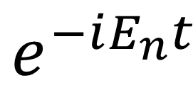
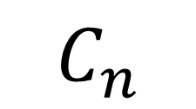
Time dependent $ψ(x,t)$
$$C_{n}$$
$$φ_{n}$$
$$e^{−iE_{n}t}$$
$$∙$$
$$∙$$

Slide 14
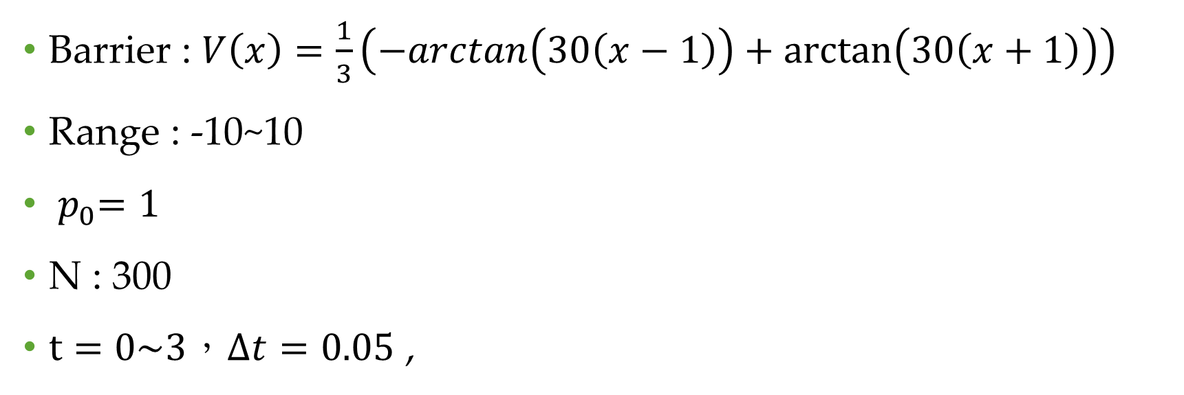
Condition
Barrier : $V\left(x\right)=\frac{1}{3}\left(−arctan\left(30\left(x−1\right)\right)+\arctan\left(30\left(x+1\right)\right)\right)$
Range : -10~10
${ p}_{0}=1$
N : 300
$t=0\sim 3，Δt=0.05$ ,

Slide 15
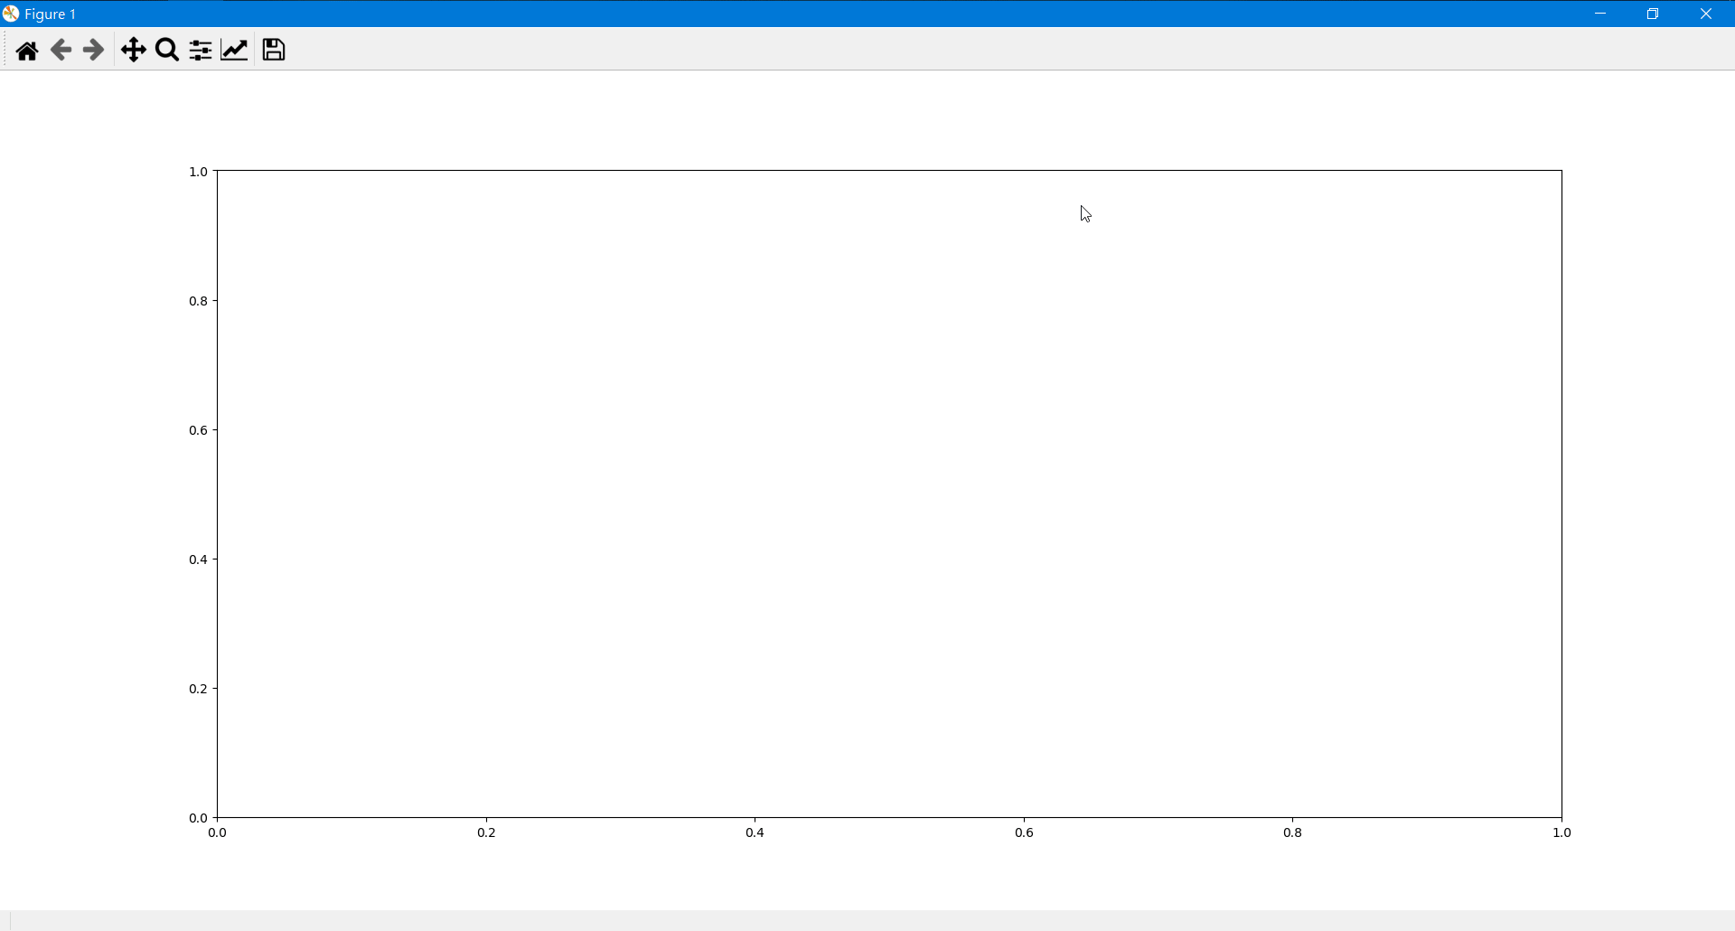

Slide 16
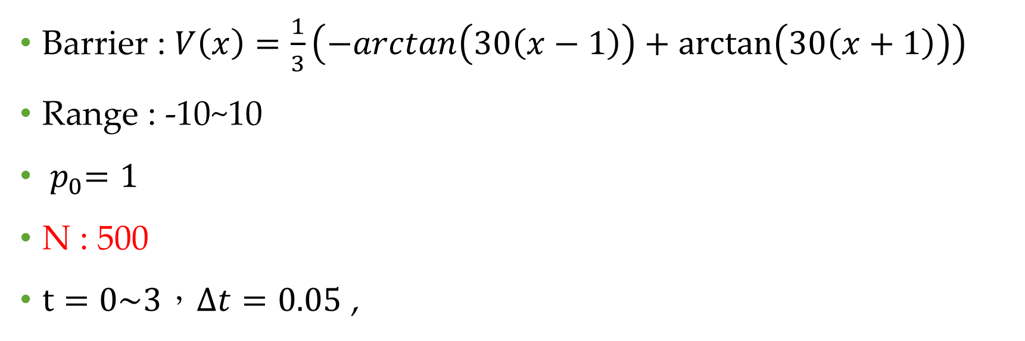
Condition
Barrier : $V\left(x\right)=\frac{1}{3}\left(−arctan\left(30\left(x−1\right)\right)+\arctan\left(30\left(x+1\right)\right)\right)$
Range : -10~10
${ p}_{0}=1$
N : 500
$t=0\sim 3，Δt=0.05$ ,

Slide 17
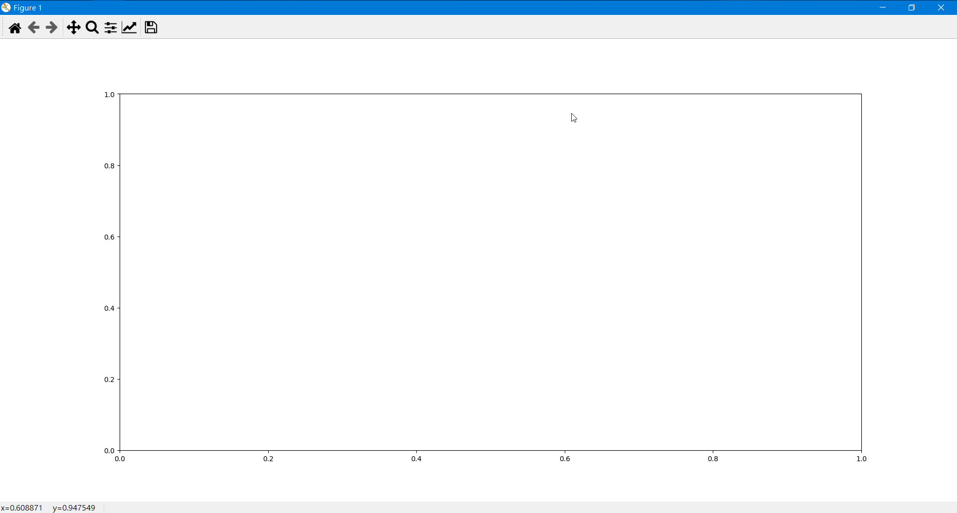

Slide 18
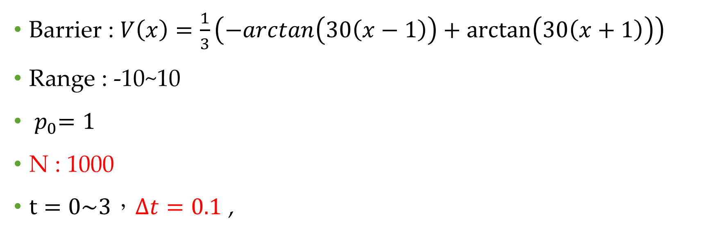
Condition
Barrier : $V\left(x\right)=\frac{1}{3}\left(−arctan\left(30\left(x−1\right)\right)+\arctan\left(30\left(x+1\right)\right)\right)$
Range : -10~10
${ p}_{0}=1$
N : 1000
$t=0\sim 3，Δt=0.1$ ,

Slide 19
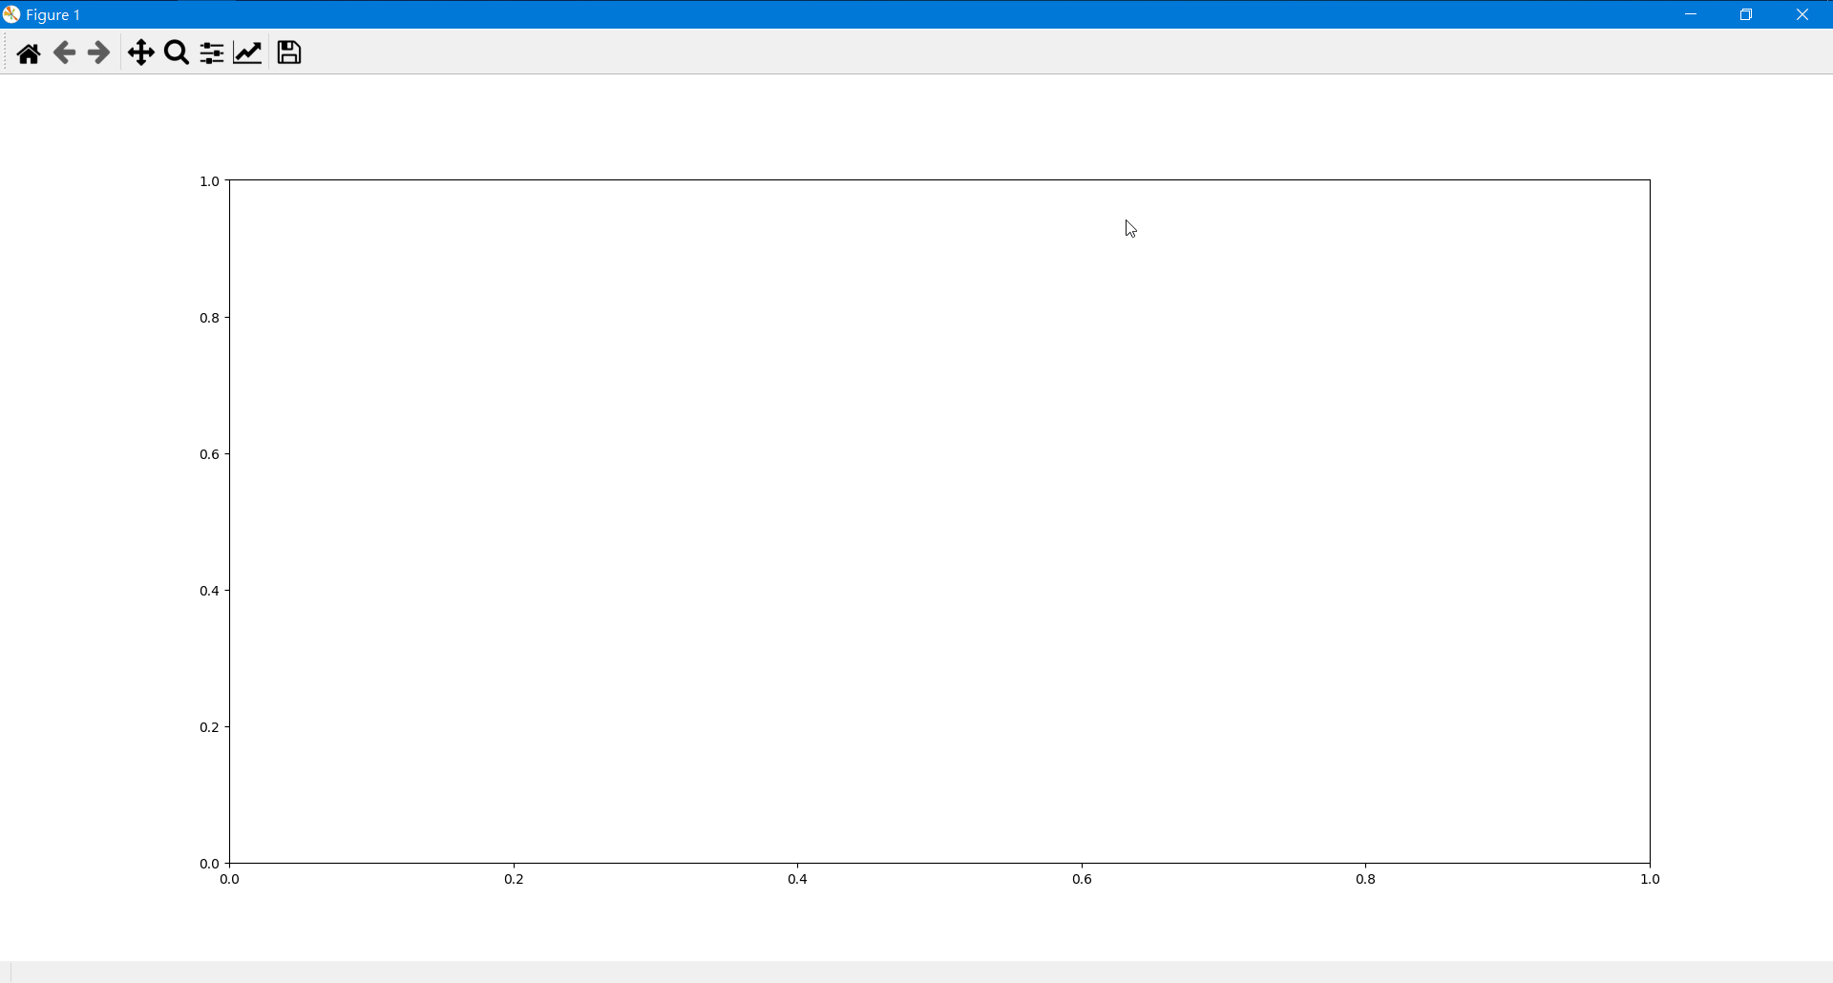

Slide 20
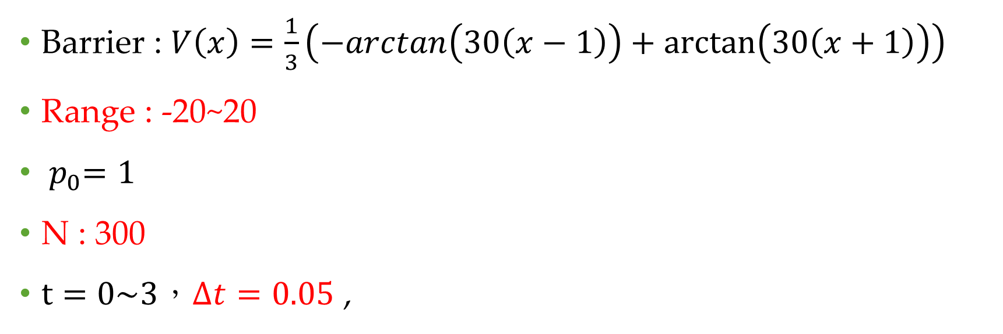
Condition
Barrier : $V\left(x\right)=\frac{1}{3}\left(−arctan\left(30\left(x−1\right)\right)+\arctan\left(30\left(x+1\right)\right)\right)$
Range : -20~20
${ p}_{0}=1$
N : 300
$t=0\sim 3，Δt=0.05$ ,

Slide 21
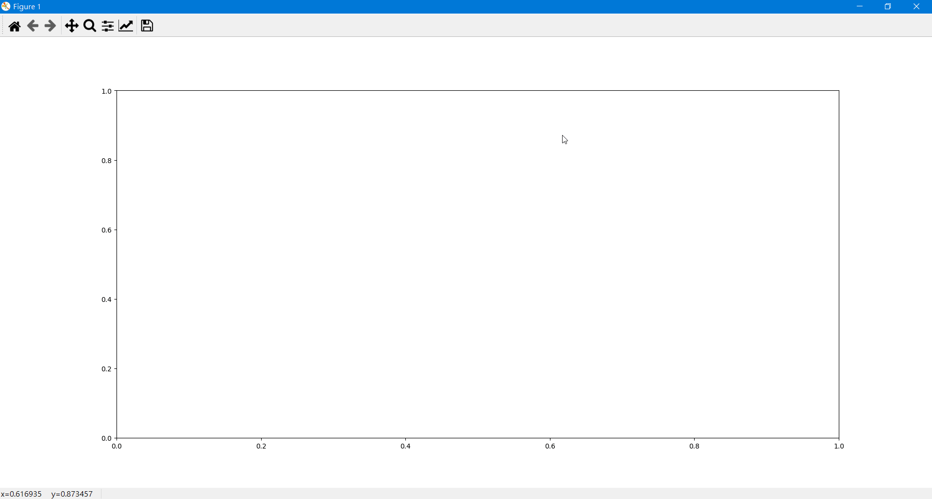

Slide 22
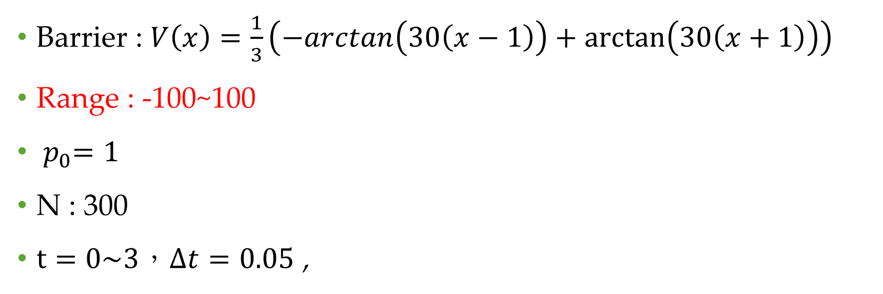
Condition
Barrier : $V\left(x\right)=\frac{1}{3}\left(−arctan\left(30\left(x−1\right)\right)+\arctan\left(30\left(x+1\right)\right)\right)$
Range : -100~100
${ p}_{0}=1$
N : 300
$t=0\sim 3，Δt=0.05$ ,

Slide 23
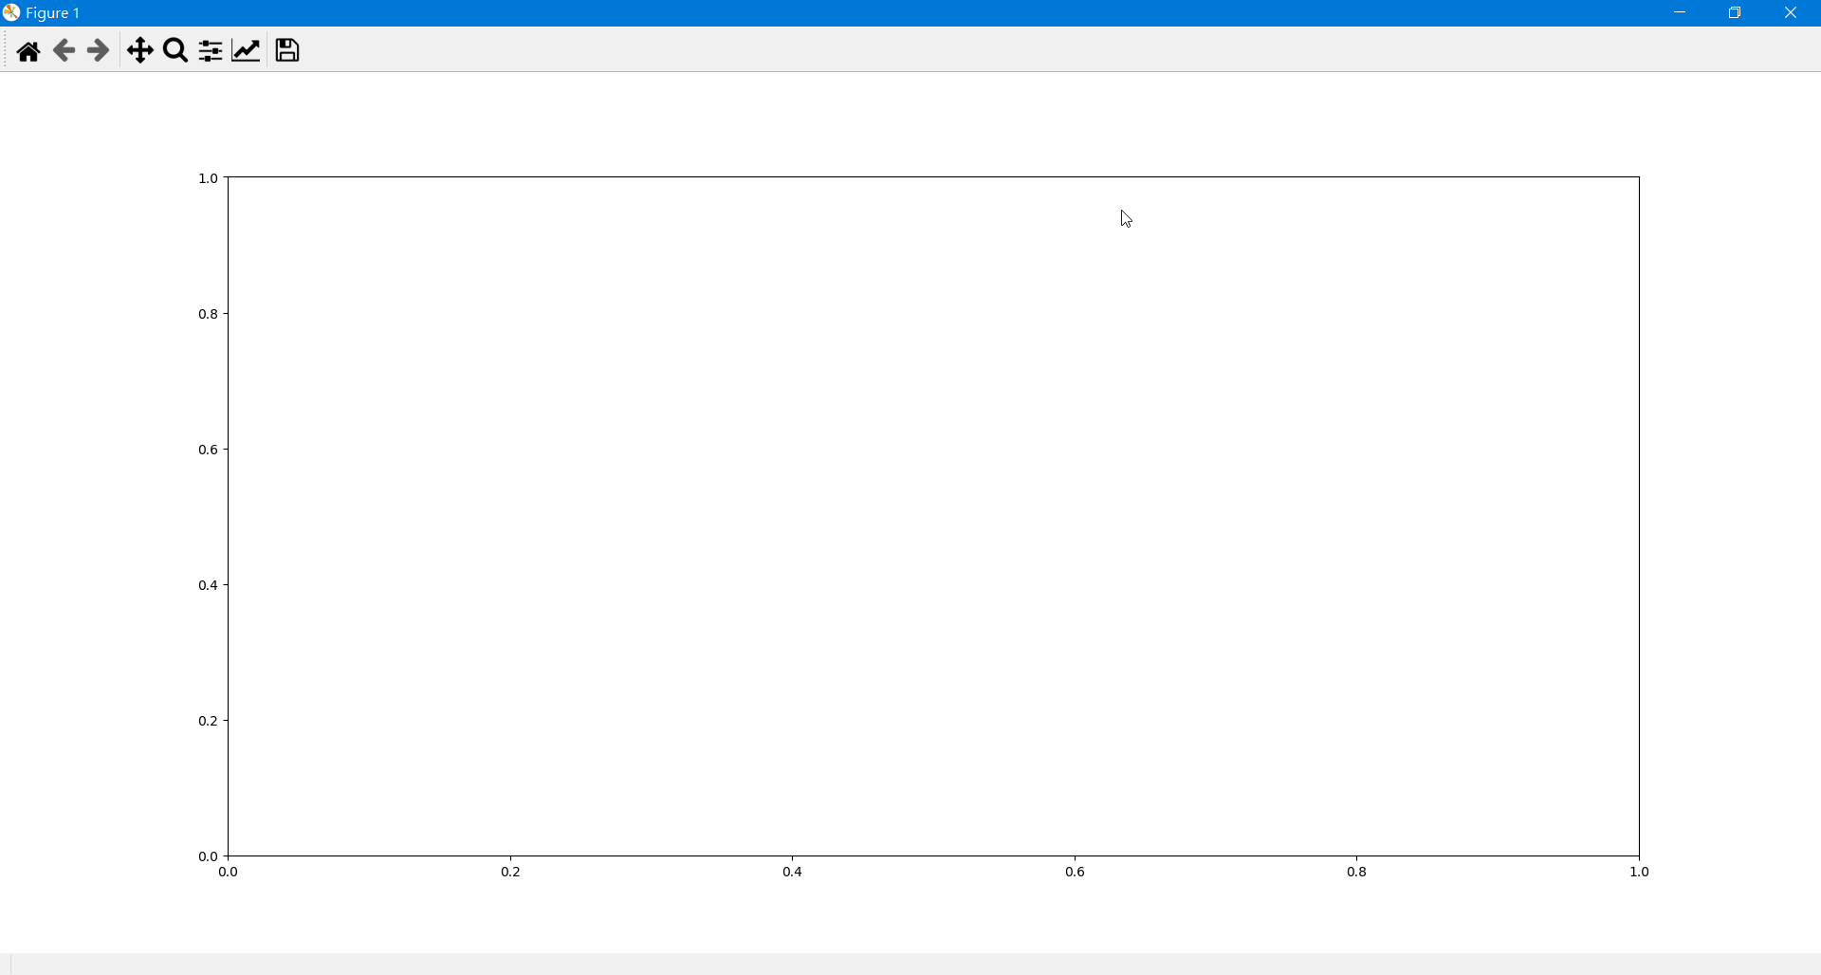

Slide 24
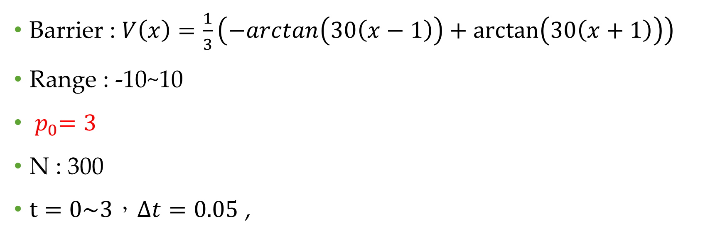
Condition
Barrier : $V\left(x\right)=\frac{1}{3}\left(−arctan\left(30\left(x−1\right)\right)+\arctan\left(30\left(x+1\right)\right)\right)$
Range : -10~10
${ p}_{0}=3$
N : 300
$t=0\sim 3，Δt=0.05$ ,

Slide 25
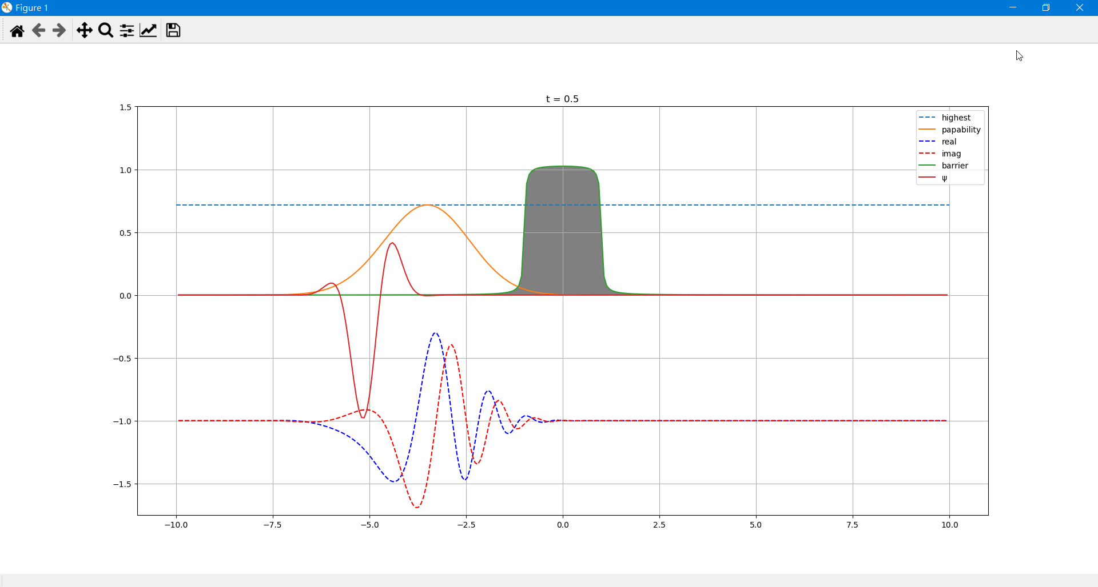

Slide 26
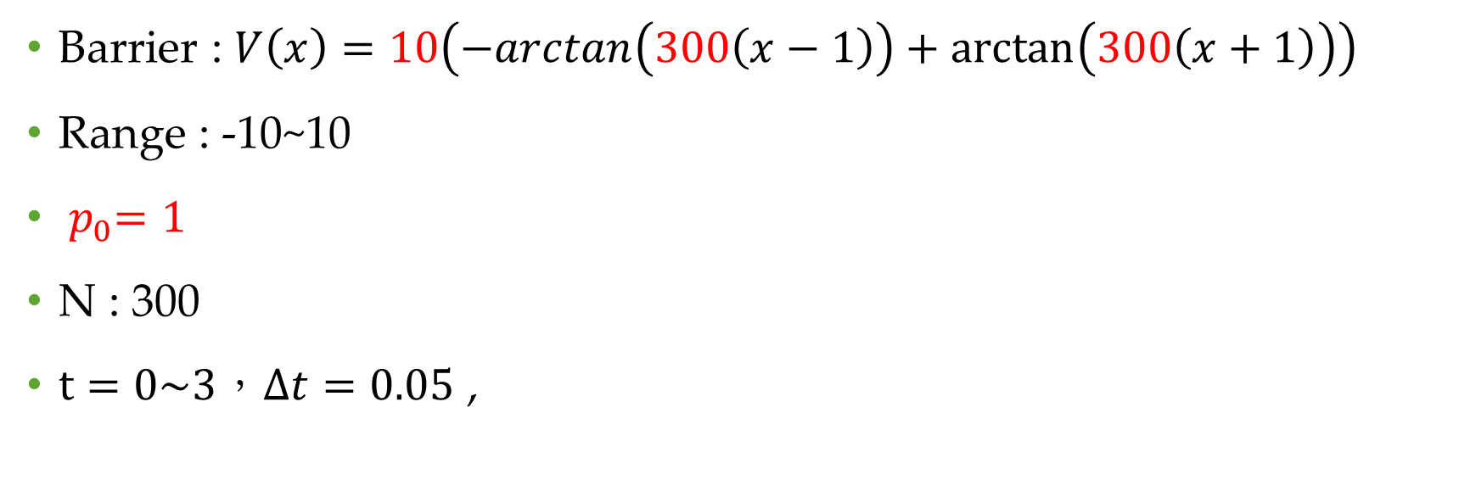
Condition
Barrier : $V\left(x\right)=10\left(−arctan\left(300\left(x−1\right)\right)+\arctan\left(300\left(x+1\right)\right)\right)$
Range : -10~10
${ p}_{0}=1$
N : 300
$t=0\sim 3，Δt=0.05$ ,

Slide 27


Slide 28
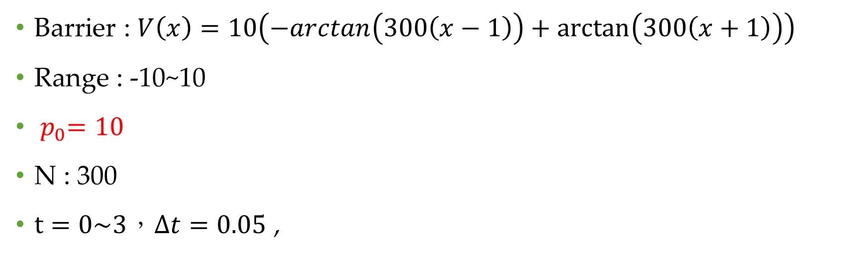
Condition
Barrier : $V\left(x\right)=10\left(−arctan\left(300\left(x−1\right)\right)+\arctan\left(300\left(x+1\right)\right)\right)$
Range : -10~10
${ p}_{0}=10$
N : 300
$t=0\sim 3，Δt=0.05$ ,

Slide 29


Slide 30
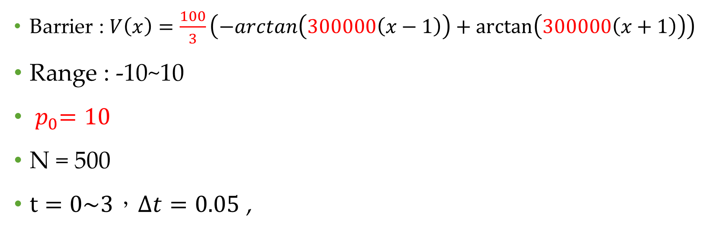
Condition
Barrier : $V\left(x\right)=\frac{100}{3}\left(−arctan\left(300000\left(x−1\right)\right)+\arctan\left(300000\left(x+1\right)\right)\right)$
Range : -10~10
${ p}_{0}=10$
N = 500
$t=0\sim 3，Δt=0.05$ ,

Slide 31
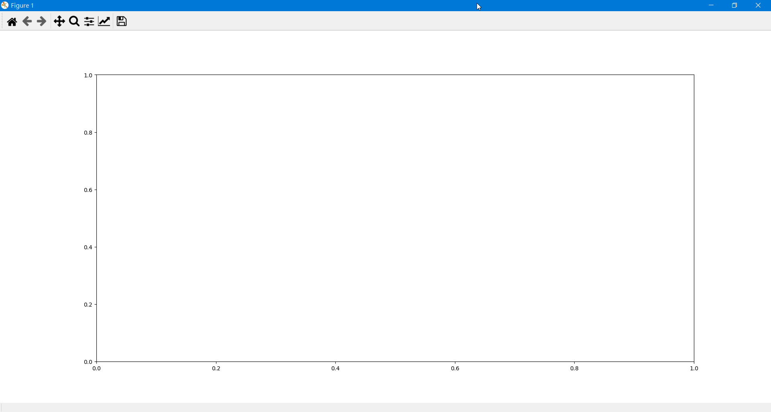

Slide 32
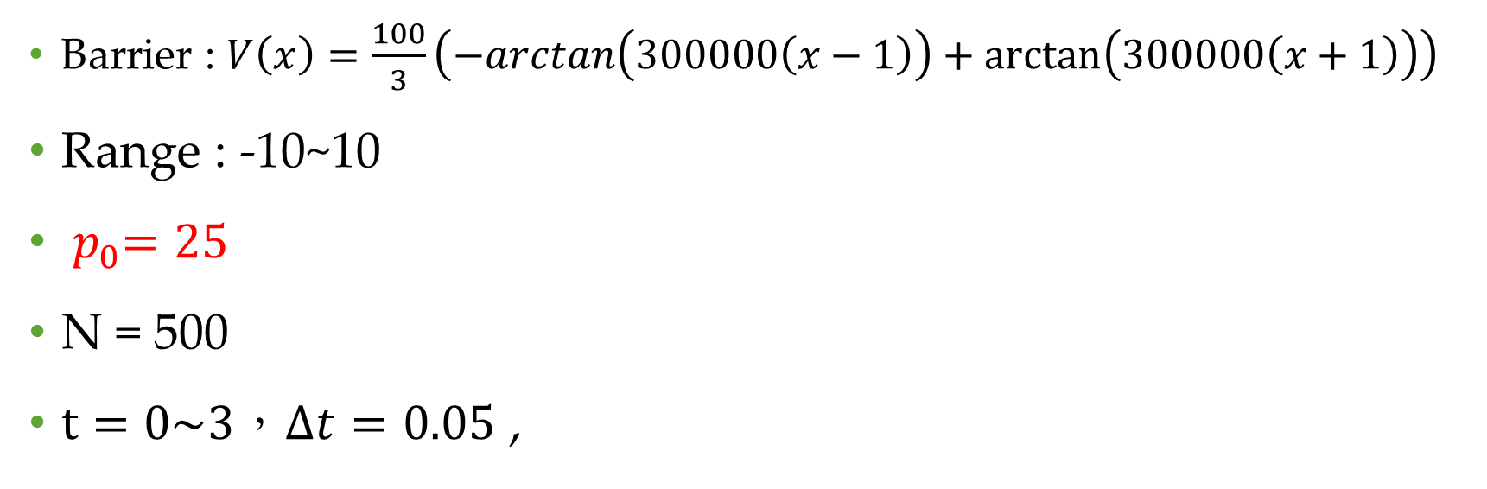
Condition
Barrier : $V\left(x\right)=\frac{100}{3}\left(−arctan\left(300000\left(x−1\right)\right)+\arctan\left(300000\left(x+1\right)\right)\right)$
Range : -10~10
${ p}_{0}=25$
N = 500
$t=0\sim 3，Δt=0.05$ ,

Slide 33


